Slide 1
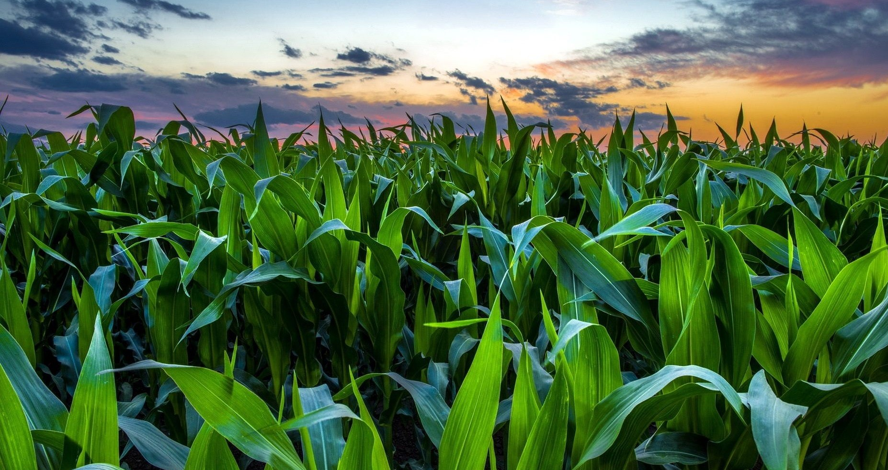
Impacts to Corn Yield based on Weather Variation
Notes:
We were assigned a task from Angela Bowman from the Analytics team within John Deere’s Intelligent Solution Group
Introduce our group members
The main goal of our assignment was to identify impacts to corn yield based on weather variation, we will go into detail about the overview of our process in the next slide.

Slide 2
Objective and Methodology
To find out significant biophysical properties that affect crop yields in various climate locations in Illinois in 2017
Offer insights to customers about weather patterns to influence land management decisions
Apply various types of analysis on our data including PCA, cluster analysis, and some penalized regression modeling
Notes:
The objective of our project was to find out significant biophysical properties that affect crop yields in various climate locations in Illinois from the year 2017. We were tasked with offering insights to customers about weather patterns to potentially influence land management decisions in the future.
We analyzed the impacts to corn yields based on weather variation factors such as precipitation, wind speed, and various temperature measurements. We applied various types of analysis on our data including Principal Component Analysis, cluster analysis, and some penalized regression modeling.

Slide 3
Data Description
There are datasets from 19 different weather station locations amongst Illinois
54 variables
25 continuous variables
29 categorical variable including error flag
Some missing variables & potential data cleaning in the future
Notes:
We obtained our data from the National Agricultural Statistics Service at the county level for the state of Illinois. Our dataset included data from 19 different weather station locations amongst Illinois. The full dataset had 54 variables, 25 continuous variables, 29 categorical variables and some missing variables. This led to data cleaning to prepare for our analysis.

Slide 4
Exploratory Data
Analysis & Insights
After removing observations with missing value in any variables, the dataset contains 6892 observations with 29 variables.
The data we got had information from many years, but we subsetted that to include only data within the growing season from 2017.
Notes:
After removing observations with missing values in any variables, the dataset contained 6892 observations with 29 variables. The data we got had information from many years, but we subsetted that to include only data within the growing season from the year 2017. For reference, the growing season is from april 1st to september 30th.

Slide 5
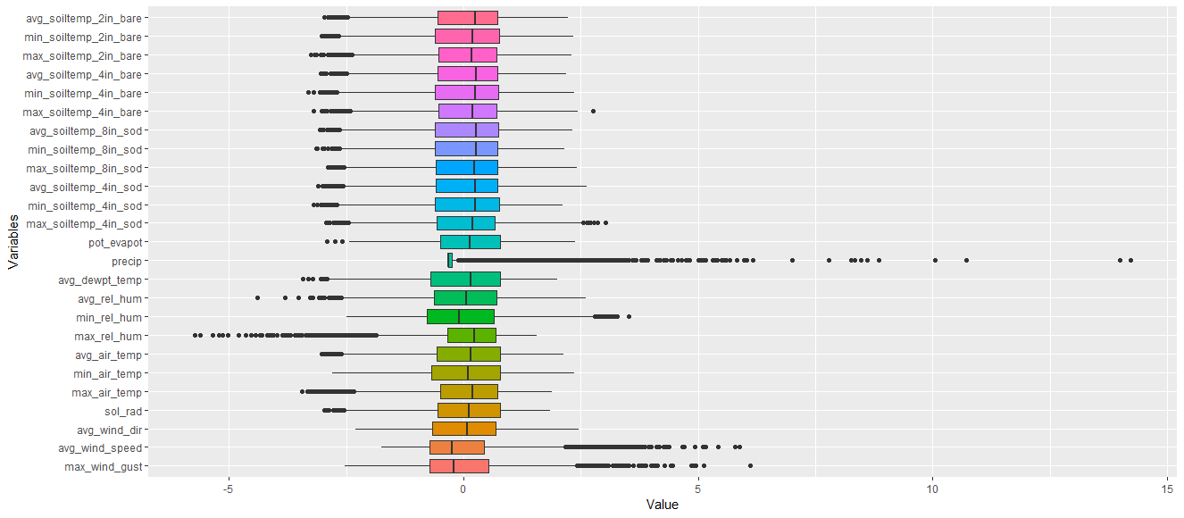
Box Plots
Notes:
This box plot shows the distribution of each variables in our data. By looking at the boxplot, we realized that the interquartile range of precipitation is smaller than other variables. Since our variables have different unit, we decided to scale and normalize variables in order to find out which variable impacts mostly to corn yield by using principal component analysis.

Slide 6
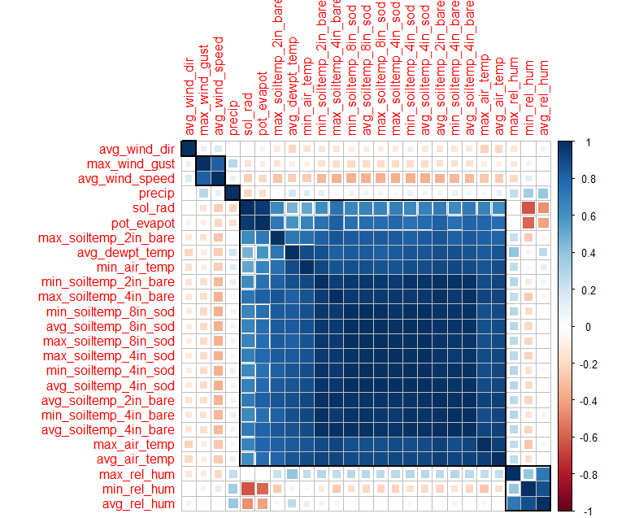
Correlation Matrix
Notes:
The correlation matrix above shows correlations between all of the variables. We will use this plot to help determine which subset of predictors to use for our model. In order to remove multicollinearity issues, we subsetted our variable list using a threshold of 0.8 because highly correlated variables make inference difficult and the potential model in the future prone to overfitting.

Slide 7
Variable Selection
Sol_rad
Precip
Pot_evapot
Avg_rel_hum
Avg_air_temp
Avg_wind_dir
Avg_wind_speed
Avg_dewpt_temp
Avg_soiltemp_4in_sod
Notes:
We have decided to proceed with these variables. Instead of using the minimum/maximum extreme values, we decided to proceed with the average values. The reason why we chose the average values for many of the metrics is they were highly correlated. We also included some varied weather parameters. When choosing the type of soil measurement to choose, we had to do some extra research and came to the conclusion that we would use the 4 inch sod soil temperature. We found out that sod is an insulator so it is less susceptible to changes in temperature which would lead to less variability within our data.

Slide 8
Initial Steps and Identification of Methods
We used principal component analysis in order to help identify and create our clusters
At this point, our approach for modeling the corn yield is to do a cluster analysis based on weather patterns
Notes:
So our initial steps for analysis and identification of methods is as follows.
We used principal component analysis in order to identify and create our clusters.
Our approach for modeling the corn yield is to do a cluster analysis based on weather patterns

Slide 9
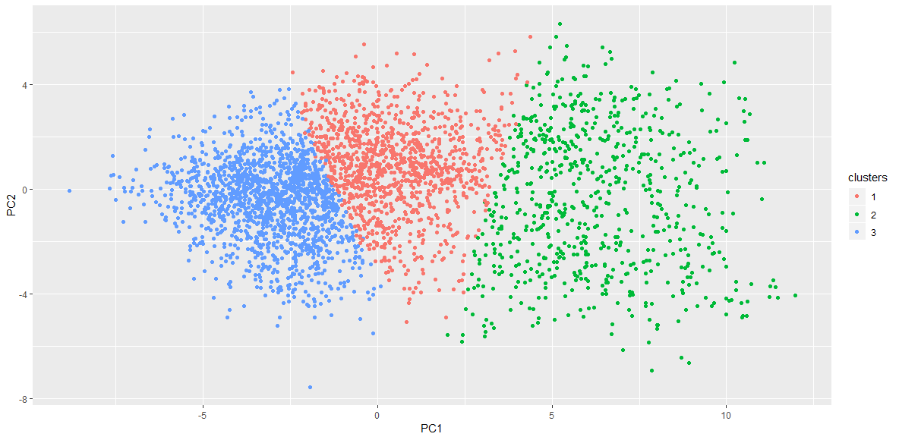
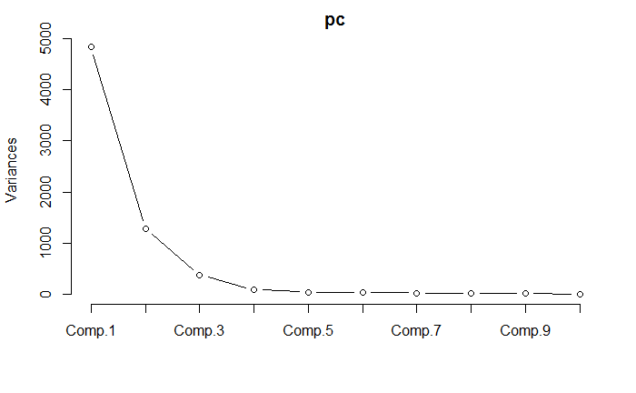
Principal Component Analysis
Notes:
In order to better visualize our data, we decided to do an initial principal component analysis. This method of analysis reduces the dimension of large datasets and allows us to distinguish the impacts of certain variables on a model. Based on the scree plot we see that the first three components explain the most variation in the data. This method was also used to identify variable importance.

Slide 10
PCA Coefficient Analysis
 | max_wind_gust | avg_wind_speed | avg_wind_dir | sol_rad | max_air_temp | min_air_temp | avg_air_temp | max_rel_hum | min_rel_hum | avg_rel_hum | avg_dewpt_temp | precip | pot_evapot | max_soiltemp_4in_sod | min_soiltemp_4in_sod | avg_soiltemp_4in_sod
PC1 | 0.0773 | 0.111 | -0.025 | -0.103 | -0.230 | -0.220 | -0.238 | -0.041 | 0.025 | -0.011 | -0.217 | 0.040 | -0.139 | -0.247 | -0.249 | -0.254
PC2 | -0.037 | 0.009 | 0.053 | 0.393 | 0.082 | -0.109 | 0.016 | -0.297 | -0.452 | -0.472 | -0.211 | -0.259 | 0.375 | -0.001 | -0.082 | -0.041
Notes:
Looking at the coefficients of the principal components, we can see that principal component one contrasts all of the temperature values along with some humidity values with precipitation, wind speed, and wind gust. There seems to be a distinction between those weather features. The following principal components have different distinctions, but it is not quite clear what factors they are separating out.
Loadings

Slide 11
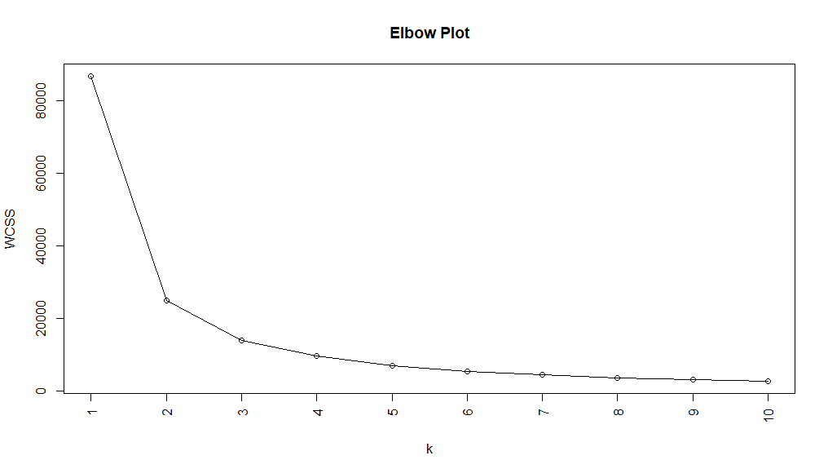
Choosing the best k-means k-value
Within Cluster Sum of Squares
Notes:
Based on the elbow plot above, we have decided that we will proceed using 3 clusters as it is the optimal point. At k=3, the addition of another cluster does not give much better modeling of the data. The clusters are split amongst the variation in weather patterns. The clustering technique that we were using was k-means.

Slide 12
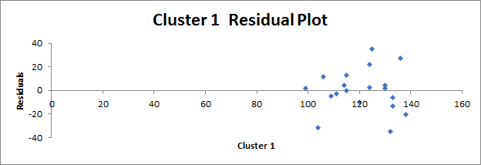
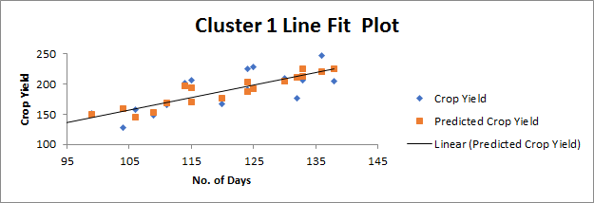
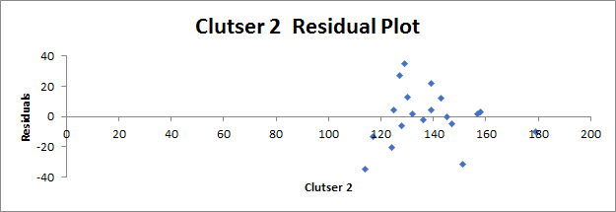
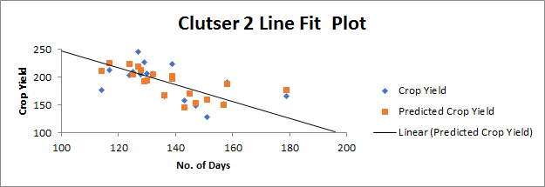
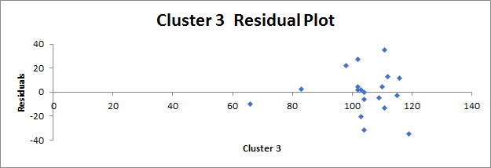
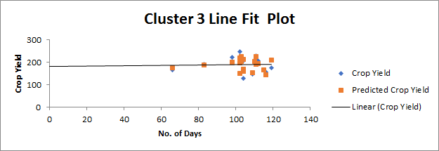
Cluster Analysis
 | Cluster 1 | Cluster 2 | Cluster 3 | Crop Yield
bbc | 130 | 125 | 110 | 209.4
brw | 115 | 145 | 104 | 170.3
bvl | 130 | 132 | 103 | 206.8
cmi | 115 | 130 | 112 | 206.8
dek | 138 | 124 | 103 | 204.1
dxs | 99 | 157 | 102 | 151.9
fai | 106 | 143 | 116 | 157.6
fre | 133 | 128 | 104 | 206
frm | 111 | 136 | 115 | 165.4
icc | 125 | 129 | 111 | 227.9
llc | 124 | 139 | 98 | 224.4
mon | 136 | 127 | 102 | 246.7
oln | 109 | 147 | 109 | 148
orr | 124 | 158 | 83 | 191
rnd | 104 | 151 | 104 | 127.9
siu | 120 | 179 | 66 | 166.7
sni | 114 | 139 | 102 | 201.8
ste | 133 | 117 | 111 | 212.4
stc | 132 | 114 | 119 | 176.4
Notes:
The clusters are segregated by weather conditions. Initially, we did a simple linear regression on the frequency of the weather station for each cluster.
The cluster group frequency of site and crop yield data that will be used for further analysis is shown on the right. We may use ANOVA modeling to try to see if differences in frequency in each cluster affect crop yield. Performing a basic regression analysis on the frequency of days a site is in a cluster versus crop yield shows us the effects of weather conditions on crop yield. This may indicate that if a site has more days with weather conditions similar to that in cluster 1, the total crop yield may be higher.
This shows that certain patterns that positively and negatively affect total crop yield. The frequency of days prevalent in each cluster per county has an affect on crop yield.

Slide 13
Limitations & Feature Engineering
Challenges with clustering
Feature engineering to prepare our data for analysis
Creating features based on each day
Model crop yield using a penalized regression model
Notes:
Address why clustering was not good enough
Go into detail about feature engineering and why we proceeded with this method of analysis
9 features = the variables we selected for modeling
Each day for each county is a variable - Sort of like doing it as a time series, studying it as a regression - discuss.
With this, we will have a very high dimension of data, so we will be modeling using a highly penalized regression model.

Slide 14
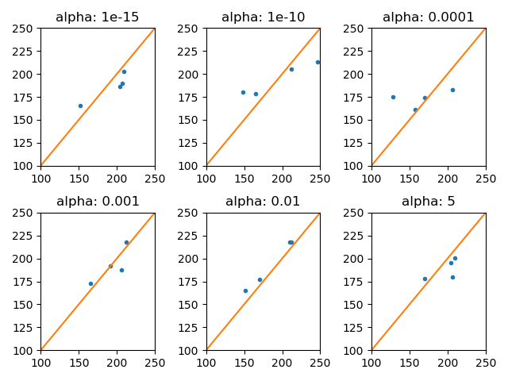
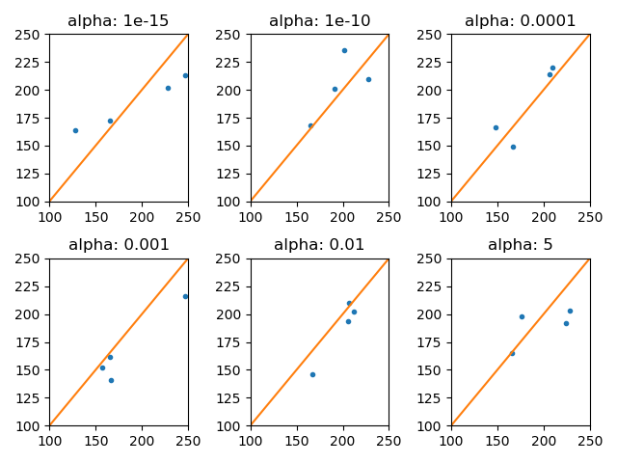
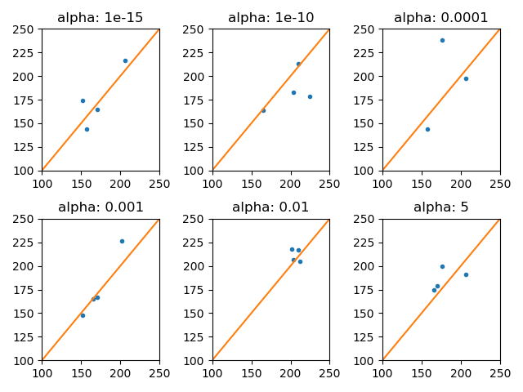
Modeling Methods
Lasso
Ridge
Elastic Net
Notes:
When modeling our data, since we proceeded with feature engineering, we wanted to use a penalized regression to account for the high amount of variables. Because of this, we decided to model using lasso, ridge, and elastic net methods.
These methods will help account for multicollinearity and overfitting. Elastic net regularization methods may also be used for modeling our data.
80 & 20 percent training & test sets using our data. We used K-fold cross validation on the tuning parameter to get the best r^2 value

Slide 15
Penalized Models Considered
Lasso
R² = 0.49
α = 0.001
Ridge
R² = 0.50
α = 10
Elastic Net
R² = 0.61
α = 0.01
Notes:
Chose r^2 as parameter to decide which model is the best
We will go ahead with elastic net - includes both lasso and ridge - controls with multicollinearity and regularization

Slide 16
Weekly Analysis
Date | Avg air_temp | Avg dewpt temp | Avg rel_hum | Avg Soiltemp 4in_sod | Avg wind_dir | Avg wind_speed | pot_evapot | precip | sol_rad
4/1/2017 - 4/7/2017 | -0.04157 | 0 | 0.09353 | 0 | 0.06649 | 0 | -0.02876 | 0.03391 | 0.00641
9/23/2017 - 9/29/2017 | 0.03911 | -0.00117 | 0 | 0 | 0.03548 | 0 | 0.01041 | 0.06274 | 0.21716
Notes:
Here are examples of two representative weeks within the growing season. We contrasted the first week of the growing season (april first to the last week of september); this information provides us insight into the importance of each variable on total crop yield during that week.
Analysis by week helps us analyze each variable’s significant impact on a weekly level. We can address changes in weather patterns amongst each week. Also, the way we did this was by averaging the daily regression data.

Slide 17
Recommendations for Monthly Land Management
Month | Influential Variable | Recommendation
April | Precipitation (-) | Decrease artificial irrigation
June | Precipitation (+) Wind direction (-) | Increase artificial irrigation Wind screens
August | Air temperature (-) | Cooling mist
Notes:
Monthly is more realistic to make recommendations on. We analyzed weekly, but practical implementation would probably be on a monthly basis.
Weeks are highly variable so based on that and the fact that managing so much land would be difficult on such a frequent weekly basis, we proceeded with making recommendations by month for practicality purposes.
One example is that for the month of april, the coefficient for precipitation was negative, meaning that it had a negative impact on crop yield so during this month (despite it being in the growing season), we would advise to decrease the use of artificial irrigation.
In the past few years, climate has changed significantly due to changes in global temperature and populations
In our opinion, controlling these factors may influence crop yield
Since it is positive, should water it.

Slide 18
Next Steps
Fine tune the model - not exactly fit for predictive modeling
Looked at the values of the coefficients
We were tasked with finding influential information, not to do full predictive modeling
Making a more efficient model may be a good next step
Notes:
Next steps
Geospatial analysis - unfortunately, none of us know GIS, but I am taking a course next semester.

Slide 19
Challenges
It is hard to recommend solutions based on only one year of data as we don’t have data to compare it to
Trying to provide time/weather based solutions without a good basis of annual comparison is quite difficult as we focused on the significance of the variables themselves
Another limitation is that some weather factors are beyond our control / don’t have practical ways to account for these weather changes - no artificial method to control them
Notes:
Avg - windspeed - screens to help with direction & speed of wind according to the impact based on coefficients
Weather is constantly changing - data of multiple years to see how weather patterns change over time
When speaking with Angela, she mentioned that John Deere has live-updating data feeds that they use for analysis which would be beneficial for more in depth analysis.

Slide 20
Conclusion
It is a good idea for determining yield impacts based on weather patterns, but there are limitations
We are able to make suggestions to assist in land management decisions. Customers can use this information to decide whether to introduce artificial irrigation or to adopt new technologies in Illinois if weather patterns continue to change

Slide 21
Thank you!
Any Questions?
Notes:
Thank you for listening to our presentation. Does anyone have any questions?

Slide 22
Any vacancies?
Notes:
Any vacancies?

Slide 23
Questions to address in analysis
1) What does a representative week look like for different weather variables? Pick different weeks
based on different patterns such as precipitation, etc, and provide some statistical information
regarding those variables. How could this potentially help with forecasting information for growers?
a. Evaluating weeks would also lend itself well to an opportunity to communicate statistical
results that people relate to and could potentially provide a good story of why it’s important.
2) Is it possible, or wise, to evaluate weather data based on clusters rather than in time series? How
does removing the time series aspect of weather information impact the physical environment? The
advantage of clusters is the development of patterns to understand zones or regions which may be
more impacted than others for total crop yields. However, the limitation is that biophysical
processes do not always act in a linear fashion. What is the tradeoff between these two processes?
3) What limitations did you identify for providing recommendations to customers based on one year of
weather information?
Notes:
Time series better for weather because dynamic process - clustering by weather.
Need to take into account time / variation between weather in different months.
How does time removing time series impact physical environment - ex. Precipitation - neglecting time series, we would get that overall precipitation is 0.05, positively influences crops, but issue is that in april, precipitation has a negative weight on crop yield (not enough), so badly influences crops - average shows that we wouldn’t have a problem. Just providing aggregate information would indicate different things - water things always. (flip this)
Negative (others constant),
First week of april
Last week of september - coefficient of
Geospatial analysis - time & scope - limited knowledge of farming (domain) and programs

